Slide 1
Improved Electrode Motion Artefact Denoising in ECG Using Convolutional Neural Networks and a Custom Loss Function
Ben Russell

Slide 2
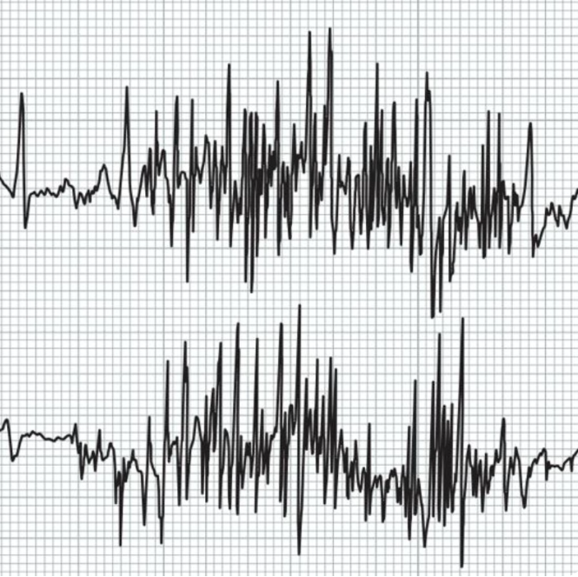
What problem does the paper attempt to solve?
We are all aware that ECG signals are prone to noise.
This noise is often significant enough to:
Completely block out important features (P, QRS, T) within an ECG.
Obscure the morphology (Distortion) of these features.
It is important that this noise is removed such that an expert (Or algorithm) can interpret the signal accurately.
However, it is impossible to create a perfect digital filter such that all of the underlying ECG signal is maintained.
The frequency content of all noise sources generally overlap with the frequency range of the PQRST complex.

Slide 3
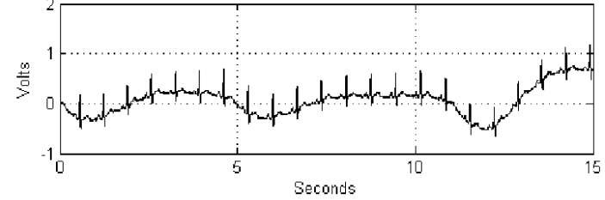
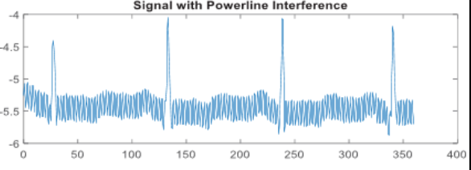
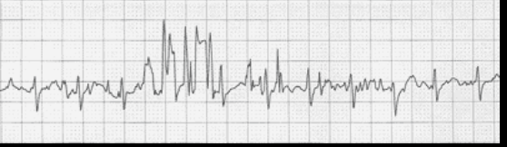
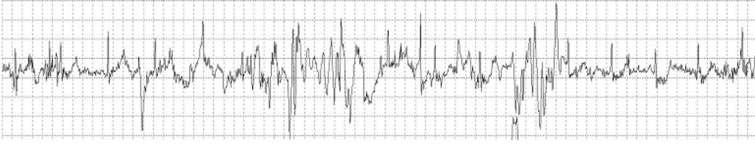
Noise Corruption in ECG
BW
Relatively easily removed using traditional DSP.
Noise Sources
In general, there are 4 primary types of noise.
Baseline Wander (BW) – Low frequency, usually occurs around 0.5Hz. Easily removed with Discrete Wavelet Transform (DWT)
Powerline Interference (PL) – Usually fixed at 50Hz (UK) or 60Hz (US) and is easily removed using a Notch filter.
3. Muscle Artefact (MA) - Can occur in the range of 20Hz to 10kHz. Most ECG signals have components in the range 0.05Hz to 150Hz so there can be significant overlap.
4. Electrode Motion (EM) – Can occur in the range 1Hz to 10Hz. There is significant overlap between the frequency spectrum of this noise, and a typical ECG.
PL
Linear & Stationary
MA
EM
Non-Linear & Non - Stationary
Require a more specialised approach. Most popular current method are adaptive filters.

Slide 4
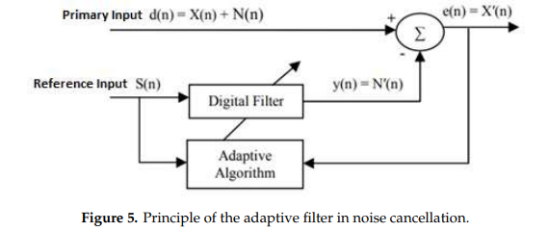
Adaptive Filters
Adaptive filters can improve the SNR of non-stationary noise; however, they have several limitations:
Adaptive filters can struggle to deal with the high variability of EM noise.
Require a reference signal as an input, it is impossible to get this perfectly and so signals have to be estimated. (Error added)
Generally, not feasible for real time processing due to computational complexity.
Not always stable depending on the amount of noise present.
If we can’t use traditional time/frequency domain DSP methods, and are looking to improve on adaptive filters, what can we try?

Slide 5
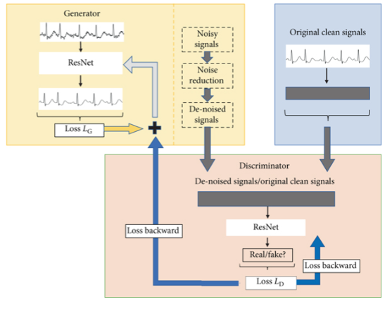
Artificial Intelligence
The introduction of AI in this field was propelled by the increasing complexity of noise types. Especially dealing with non-linear noise.
The idea is to develop data-driven algorithms that are able to learn the characteristic shape of the noise, and then remove it from the signal.
Although initial results look promising, there are still limitations:
Require large and diverse datasets for training. In the case of denoising algorithms, we need access to both the clean reference signal, and noise corrupt signal which is challenging to obtain.
Can risk overfitting on training data, meaning it could perform poorly on unseen data.
Models can get extremely complex since we are dealing with time-series data. (“Black-Box Problem”)
Training and deploying AI models (especially deep learning) can require significant computation resource, some models may not be suitable for real time processing.
Example of AI in denoising: Generative Adversarial Residual Network for ECG denoising.

Slide 6
Paper
Based on previous work, the authors opt to use Convolutional Neural Networks (CNN) due to the improved performance over LSTM networks.
The main novelty in this work is that they employ a custom loss function to try and improve the learning ability.
Loss functions are statistical measures that evaluate the model's performance.
MSE – Mean squared error between predicted and reference signals (Most popular for time series)
MAE – Mean Absolute error between predicted and reference signals. (Time series)
Binary Cross-Entropy loss – Decreases as the predicted label converges to actual label (Most popular for classification problems)
The authors choose to use MSE, however create their own variant of this to try and capture the diagnostic information only. (Similar to WEDD from HK SPE Validation)

Slide 7
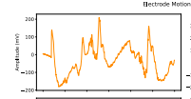

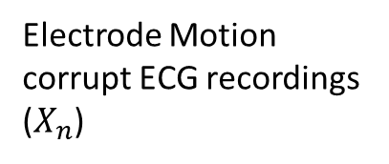
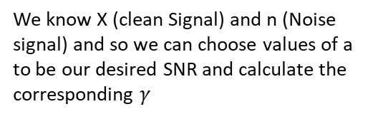
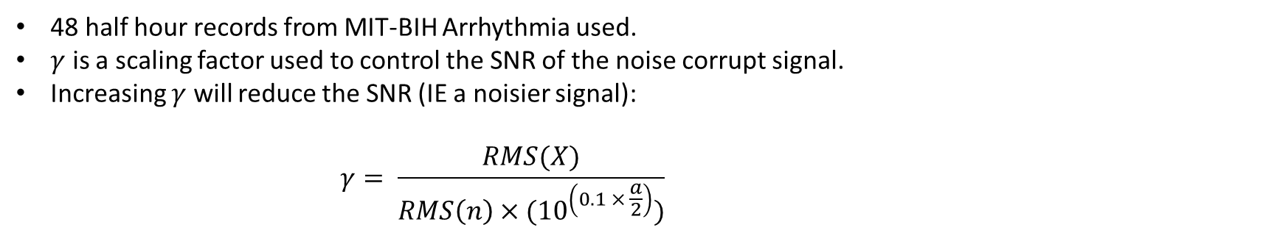
Methodology (Data)
Potential Error sources 1. Original Signals are not entirely clean 2. Is noise always linearly additive? 3. Is there enough training data? 4. Is there enough variance in the Nosie?
Training Dataset
$$X_{n}=X+(n × γ)$$
MIT-BIH Arrhythmia Database (X)
Electrode Motion corrupt ECG recordings ($X_{n}$)
MIT-BIH Noise Stress Test Database (n)
48 half hour records from MIT-BIH Arrhythmia used.
$γ$ is a scaling factor used to control the SNR of the noise corrupt signal.
Increasing $γ$ will reduce the SNR (IE a noisier signal):
$$γ= \frac{RMS(X)}{RMS\left(n\right)×({10}^{\left(0.1 × \frac{a}{2}\right)})}$$
We know X (clean Signal) and n (Noise signal) and so we can choose values of a to be our desired SNR and calculate the corresponding $γ$

Slide 8
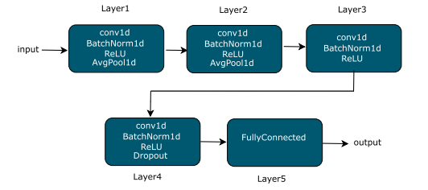
Methodology (Model)
Speeds up training speed
Four-layer convolutional network with batch normalisation and ReLU, followed by a connected layer.
Architecture has been chosen as it successfully estimated HR in previous work, this is referred to as “Transfer Learning”. However, could a different structure be used for noise removal?
Rectified Linear Units are a type of activation function, it is used here to add non-linearity into the network to deal with the complex data type.
Conv1d is a 1-dimensional convolutional layer typically used for time series data
AvgPool1d is a 1-dimensional average pooling layer used to reduce the spatial dimensions. (Reduces computational load)

Slide 9

Methodology (Loss Function)
An issue with MSE as a loss function for ECG’s is that it is global, meaning the iso-electric region is also factored into the equation.
Researchers separated the MSE into 2 components:
Standard MSE
MSE pertaining to the regions where the QRS exists.
A waiting factor is applied to the 2nd option which allows for more emphasis to be applied to the QRS.
$$L=MSE\left(X_{n}, X\right)+ α ∗ \sum_{i=1}^{j}{MSE({RX}_{n}, {RX}_{i})}$$
α is set to control the weight of QRS

Slide 10
Methodology (Evaluation)
A few different metrics are used to evaluate performance:
Performance Metric | Description
SNR Improvement | The absolute difference in the SNR before and after denoising.
HR Error Prediction | The error in HR between the signal and ground truth.
IBI | Essentially the R-R series.
HRV | Heart Rate variability in the noisy signal and denoised signal.
Qualitative Evaluation | Visual Inspection of the time series.

Slide 11
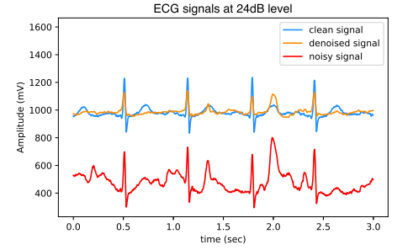
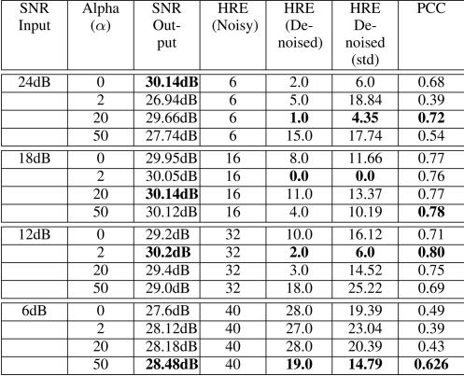
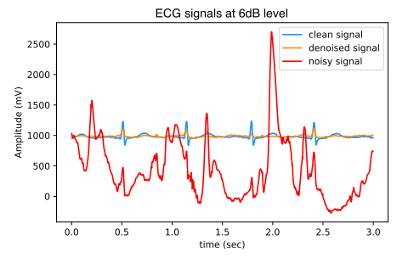

Results

Slide 12
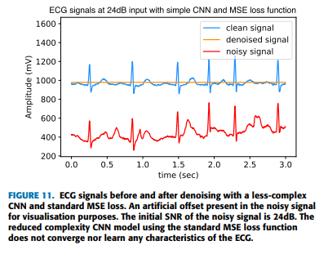
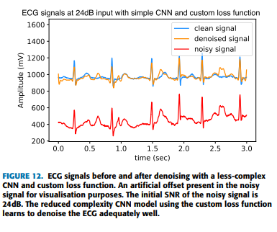
Results
Experiment was repeated for a less complex model
1562 trainable parameters rather than 2,322,180 trainable parameters.
1500 times less complex.

